Slide 1


Startup Idea Contest
[Team Name]
Team name: Explorer

Slide 2
Problem Statement
There are huge time needed to explain the main problem that face a patient to a doctor .Traditional system is very time consuming. If we reduce the time needed to serve a patience by using Artificial intelligent method then the doctor can serve more people in a day compare to previously.
[Team Name]

Slide 3
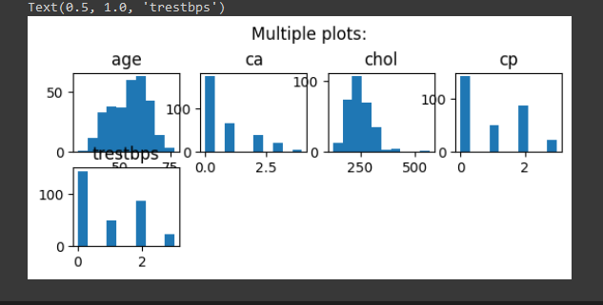
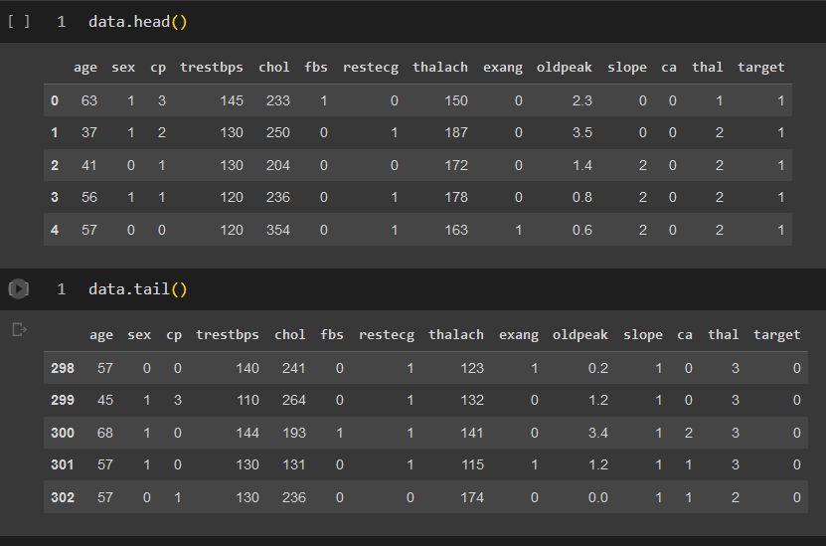
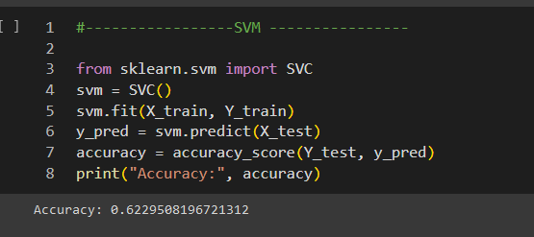
Your Solution
Create an app that take information of patient
Patient input their problem in different section before go to doctor
Doctor can read the summary of the patient problems and visualize the disease and prediction the medicine by using AI based app
Give medicine
Prediction disease using Machine learning
Explorer

Slide 4
Your Uniqueness/ Features
Get patient information like age, sex, problems, breath, oxygen level etc
Give prediction and help doctor to visualize the overall problem in a diagram
Save money
Save time for doctor
[Explorer]

Slide 5
Business Model Canvas
Give Prediction of a diseases to the doctor
Patient
Doctor helper App
Doctor
Paying money
Use app
-Patient info
-patient problem
Doctors Time save
Give medicine
[Explorer]

Slide 6
Future Plan and Scope
Create the app
Sell to doctor
Doctor Use
Patient Use
[Explorer]

Slide 7
Go to Market Strategy
Market Research:
Advantage: Conduct thorough market research to understand the needs and preferences of healthcare professionals, such as doctors, nurses, and medical staff, as well as patients. Identify pain points in the current healthcare system that your app can address.
Target Audience Identification:
Advantage: Clearly define your target audience, which may include specific medical specialties or patient demographics. Tailor your app's features and marketing efforts to cater to the needs of this audience effectively.
Competitive Analysis:
Advantage: Analyze existing healthcare apps and solutions that offer disease information collection and analysis. Identify their strengths and weaknesses to find opportunities for differentiation and improvement.
Unique Selling Proposition (USP):
Advantage: Define a compelling USP that sets your app apart from competitors. This could be superior accuracy in disease analysis, a user-friendly interface, faster data processing, or better integration with existing healthcare systems.
[Explorer]

Slide 8
Open For Questions
[Team Name]

